Slide 1


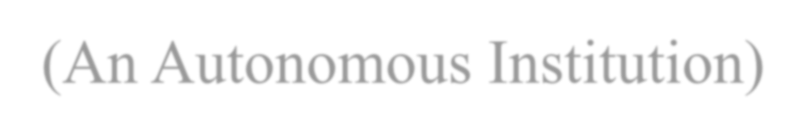
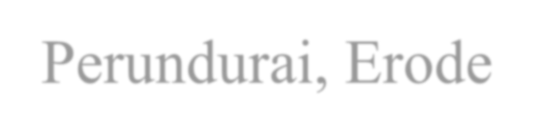

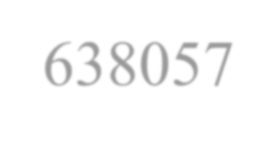
RISK GUARD
Erode Sengunthar Engineering College (An Autonomous Institution) Perundurai, Erode - 638057
AI Deepfake Risk Analysis Platform
UNDER THE GUIDANCE OF
PRESENTED BY :
Mr.Narendran R, | Abi Prasath R | (730422205002)
Assistant Professor, | Harija A | (730422205023)
Department of Information Technology | Hemabala S P | (730422205030)

Slide 2
INTRODUCTION
Rapid growth of Generative AI enables realistic synthetic
media like AI voice, images, videos, and text.
This increases risks such as deepfake scams, misinformation,
and identity impersonation.
Existing tools lack unified real-time detection, creating the
need for systems like RiskGuard.

Slide 3
ABSTRACT
RiskGuard is a unified AI risk analysis platform for detecting
AI-generated audio, video, image, and text.
Uses hybrid edge-cloud architecture for fast and accurate detection.
Focuses on privacy-first processing and real-time protection against AI-based threats.

Slide 4
EXISTING SYSTEM
Single-modality detection tools (only audio, image, or text separately).
Mostly cloud-based AI detection requiring data upload.
Manual verification without real-time automated analysis.
Limited deepfake detection in basic spam/phishing filters.
No unified multi-modal platform with privacy-focused real- time processing.

Slide 5
PROBLEM STATEMENT
AI voice cloning scams and impersonation attacks.
Deepfake videos spreading misinformation.
AI-generated phishing messages and social engineering.
Lack of unified tools capable of detecting multiple media types.
Privacy risks due to cloud-only detection systems.

Slide 6
PROPOSED SOLUTION
Real-time detection across audio, image, video, and text.
Hybrid edge-cloud processing for speed and accuracy.
Local lightweight models for instant screening.
Cloud-based deep analysis when uncertainty exists.
Accessibility-based proactive monitoring for daily applications.
Risk scoring system instead of simple binary classification.

Slide 7
SYSTEM ARCHITECTURE
Flutter mobile application for user interaction.
FastAPI backend for processing requests.
AI detection engine for media analysis.
IPFS for decentralized evidence storage.
Polygon blockchain for tamper-proof records.
Investigator dashboard for monitoring threats.

Slide 8
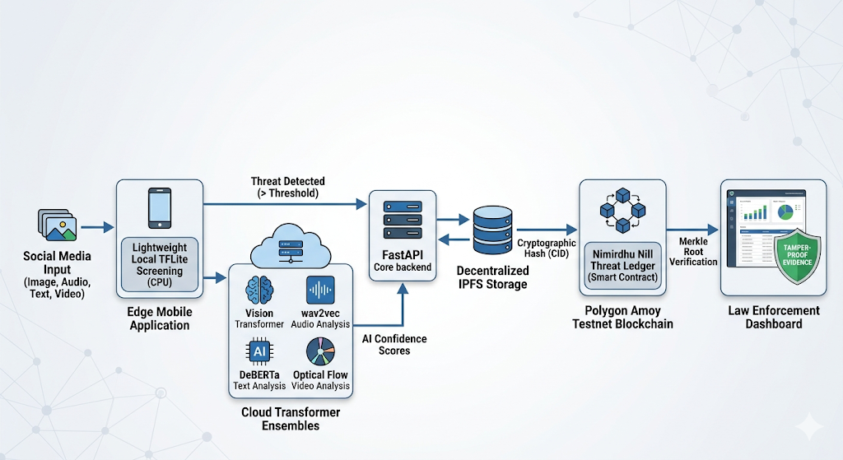
ARCHITECTURE DIAGRAM

Slide 9
AI DETECTION MODULES
Image Detection – Noise pattern & frequency analysis.
Voice Detection – LFCC and pitch pattern analysis.
Text Detection – Transformer-based AI detection.
Video Detection – Frame analysis + temporal consistency.

Slide 10
BLOCKCHAIN EVIDENCE SYSTEM
File hashed using SHA-256.
Evidence stored in IPFS.
Metadata saved in local database.
Evidence grouped using Merkle Tree.
Root hash anchored on Polygon Blockchain.

Slide 11
KEY FEATURES
Multi-modal AI content detection.
Real-time deepfake risk analysis.
Hybrid edge + cloud architecture.
Blockchain-based evidence verification.
Privacy-first local preprocessing.
Lightweight system for standard hardware.

Slide 12
THANK YOU

